Slide 1
Stores Weekly Update
Week 20 17th - 23rd May 2021

Slide 2
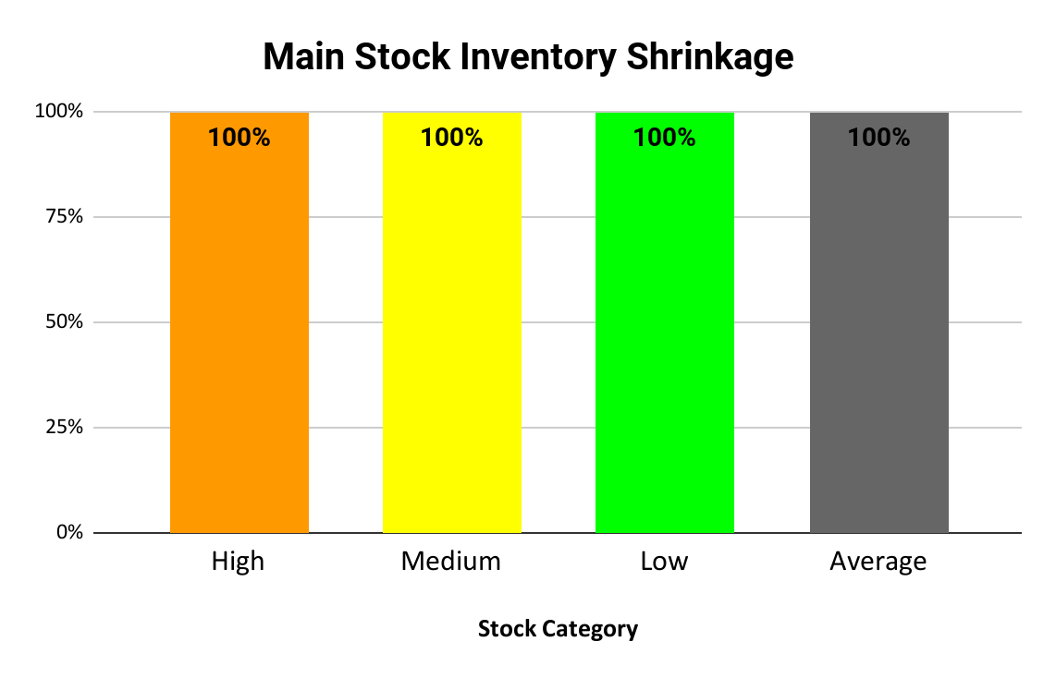
Inventory Shrinkage Report
Source Data

Slide 3
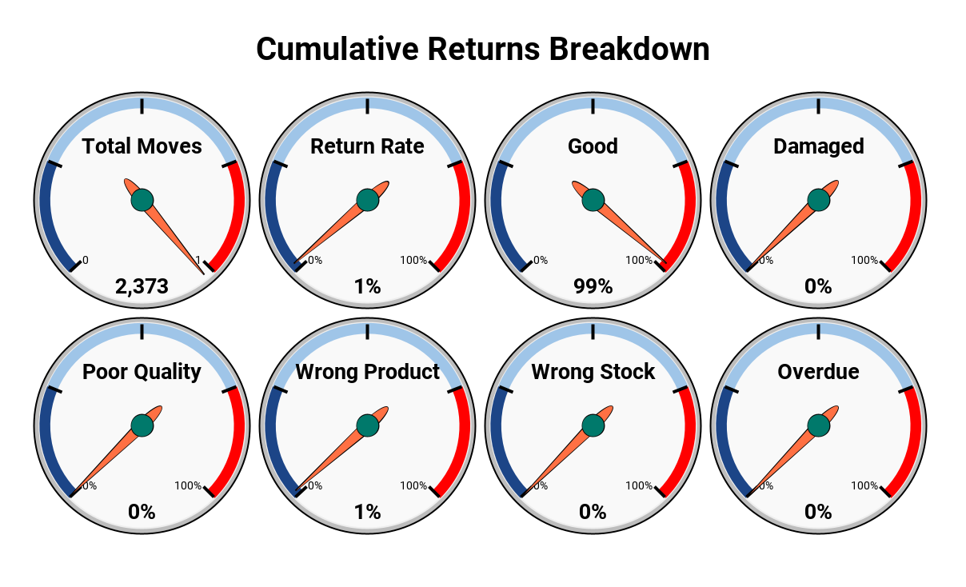
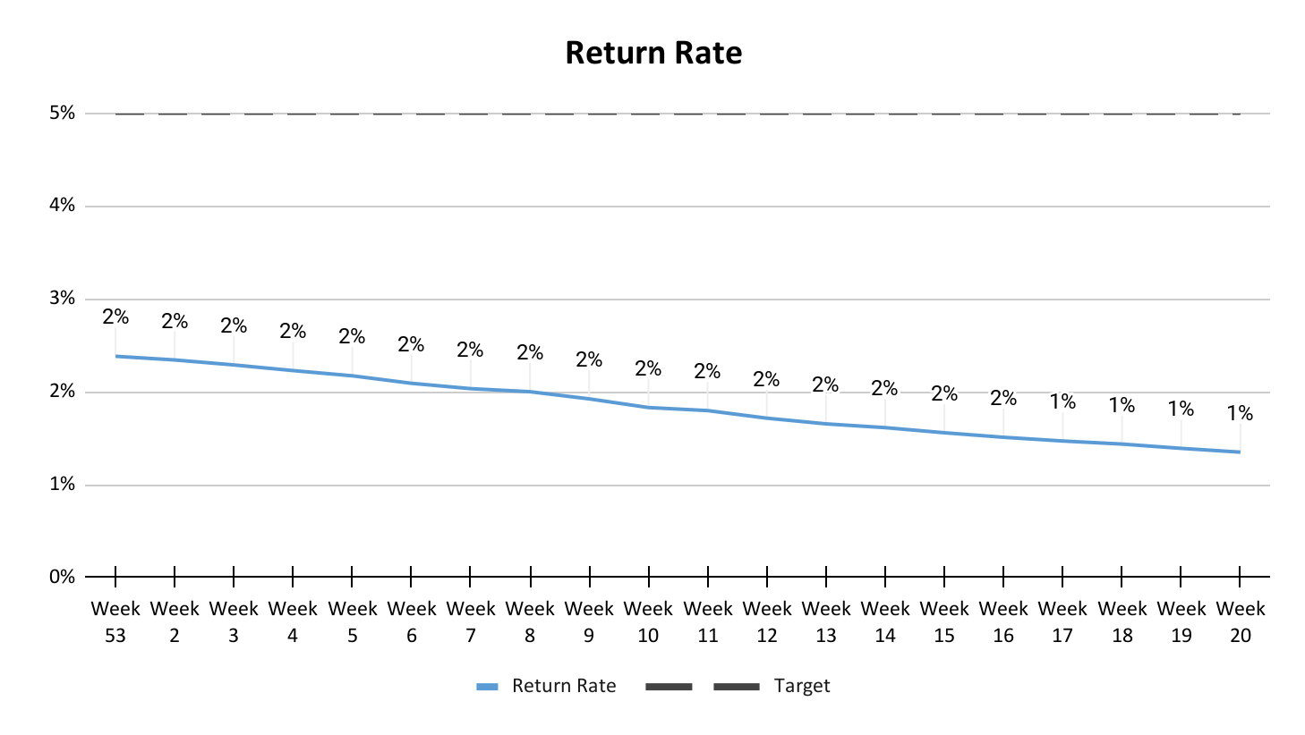
Rate Of Return Report
Source Data

Slide 4
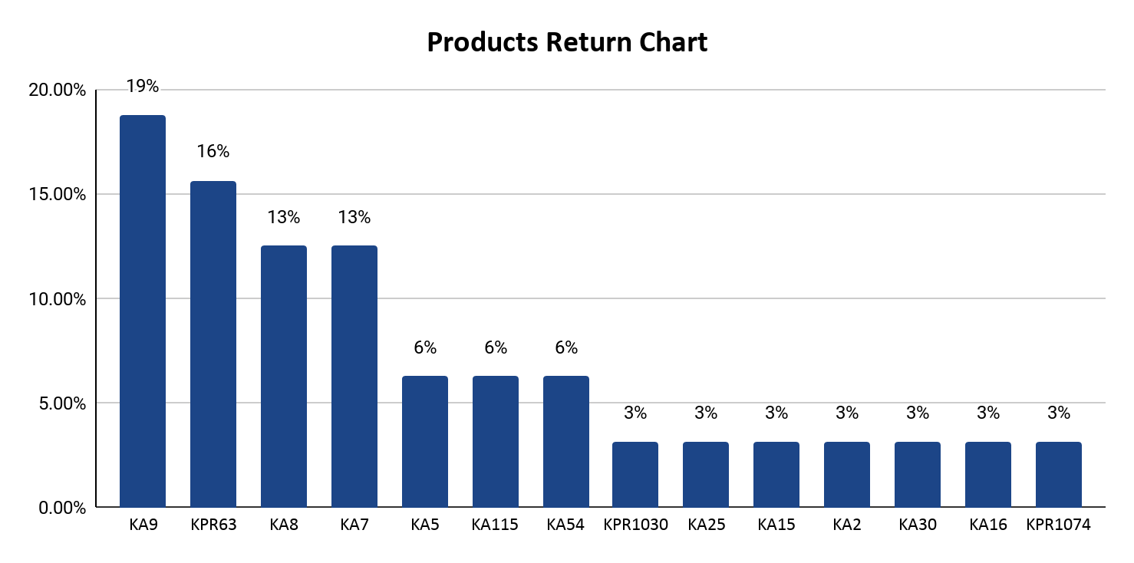
Stores Report
Source Data

Slide 5
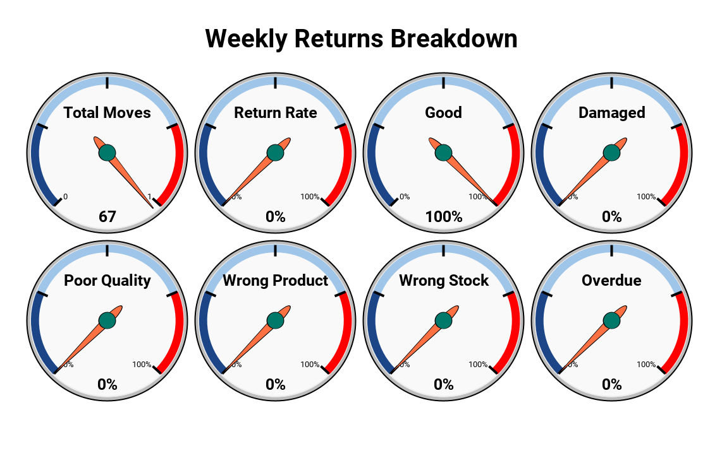
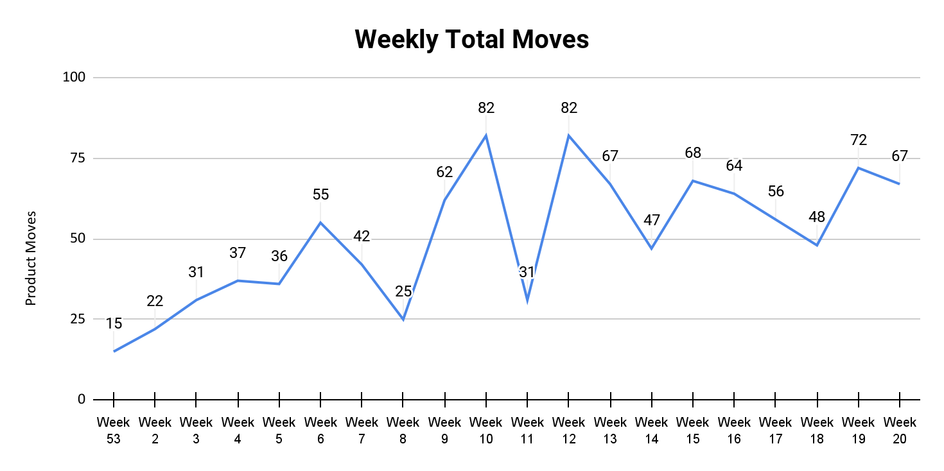
Rate Of Return Report
Source Data

Slide 6
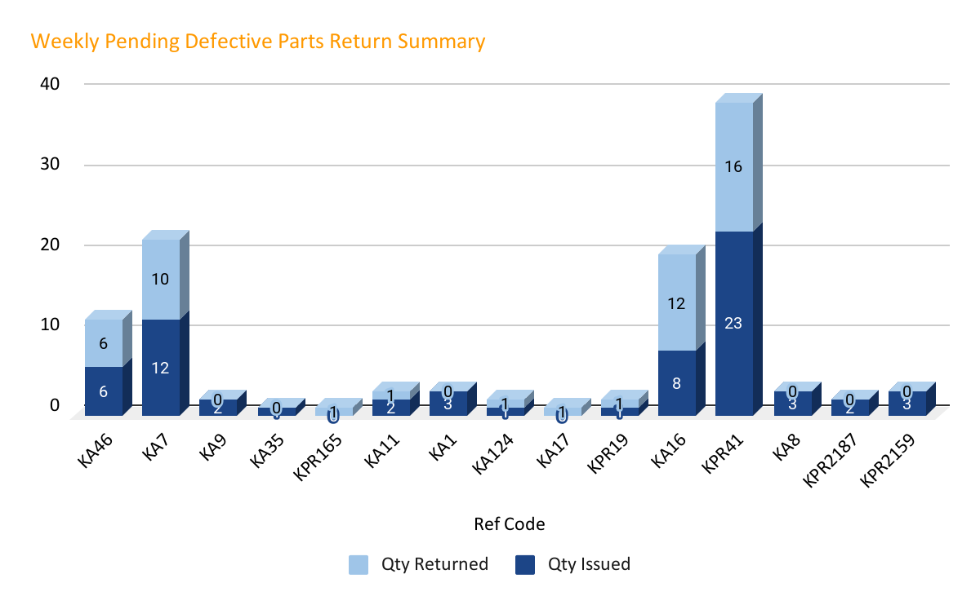
Stores Report
Source Data

Slide 7
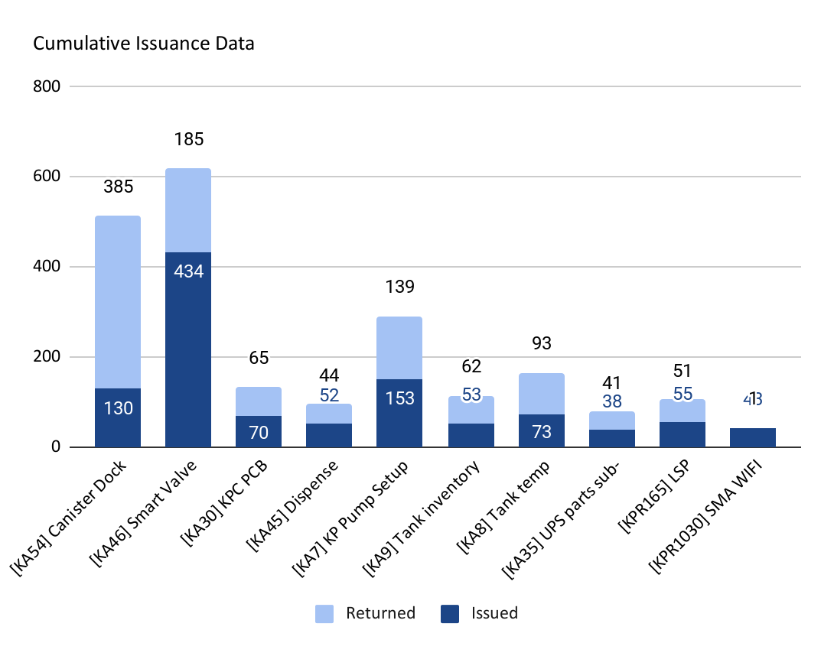
Stores Report
Source Data

Slide 8

Thank you.

